Slide 1
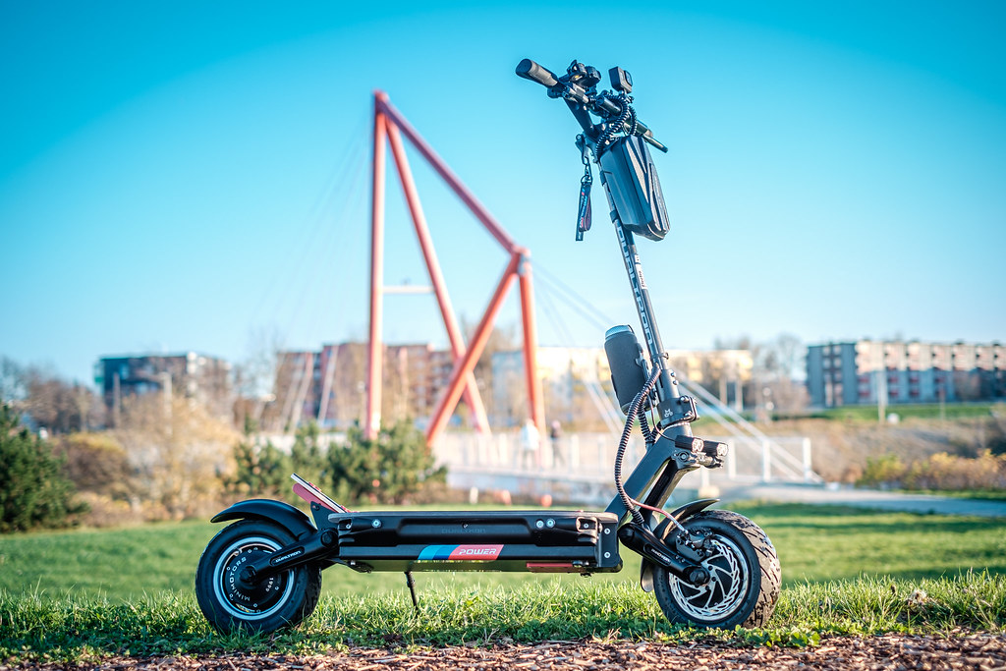

Nashville Scooters Project
Presented by: Chris, Caroline, Soham and Elizabeth

Slide 2
Agenda:
The Ask
Data Collection & Cleaning
Data Analysis
Recommendations

Slide 3
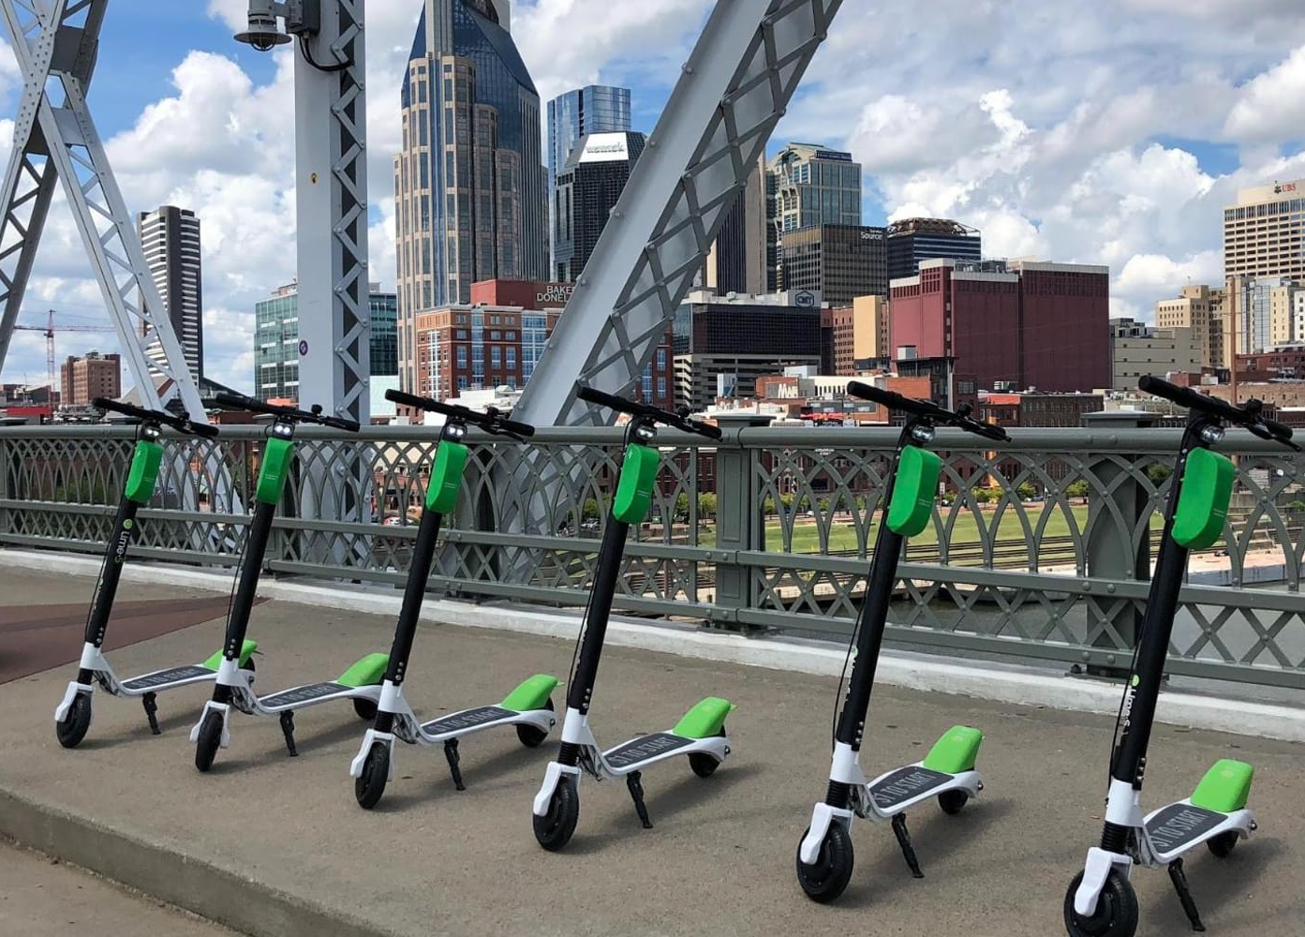
The Ask:
Metro Nashville began developing regulations for scooters and other shared urban mobility devices. In 2019, The Metro Council passed legislation enacting a one-year pilot program for scooters.
The Metro Council would like to know:
Ideal density of available scooters
Enabling scooters to serve transportation goals
Discouraging scooters from piling on sidewalks
Keeping it economically viable for companies to operate in the city

Slide 4







Data Cleaning and Collection:
After thorough analysis of the data provided by the city of Nashville, we found the 7 companies who provide shared urban mobility devices were not in compliance with the required data cleaning. The data and processing should include:
Removal of test trips of 1 minute or less ...
Removal of trips lasting more than one day

Slide 5
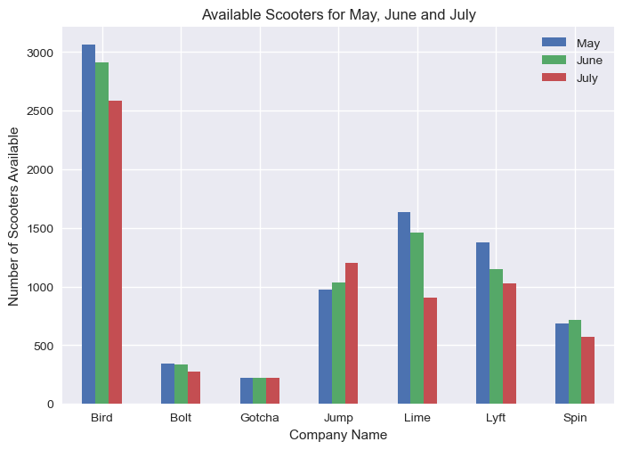
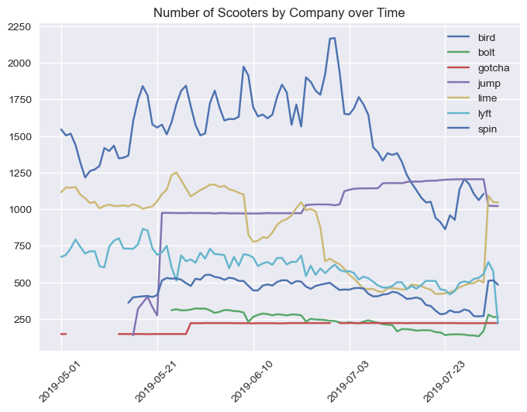
Scooter Availability
Data Analysis:

Slide 6
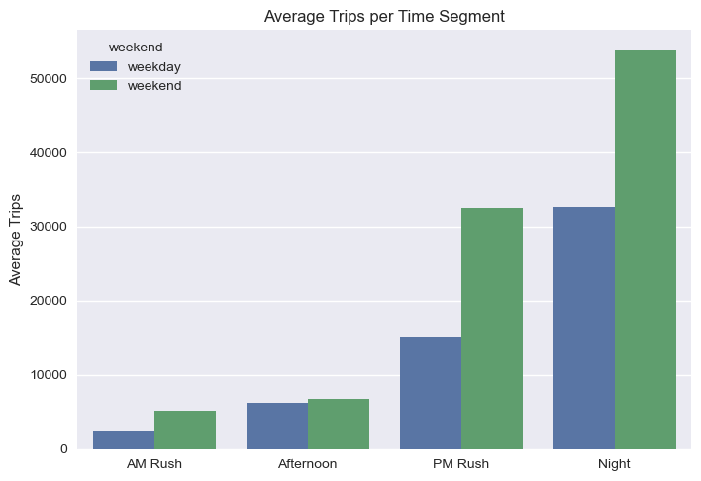
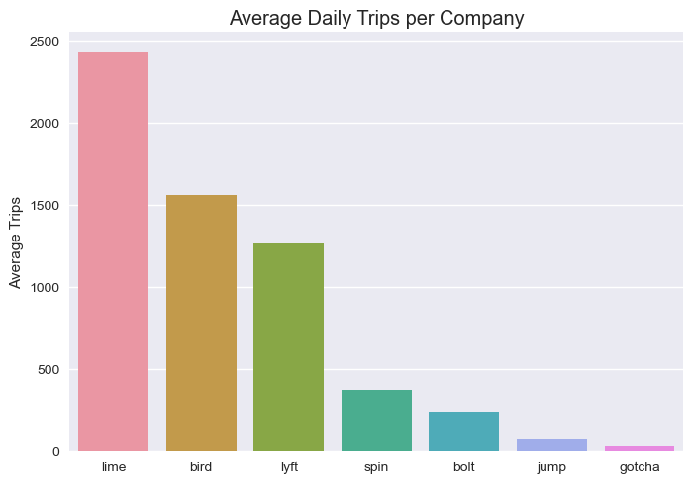
Average Trips: COMPANY/ TIME SEGMENT

Slide 7
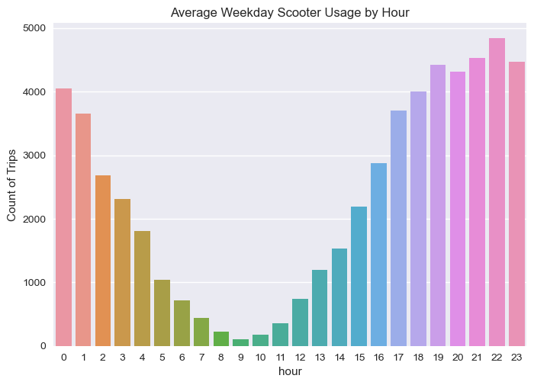
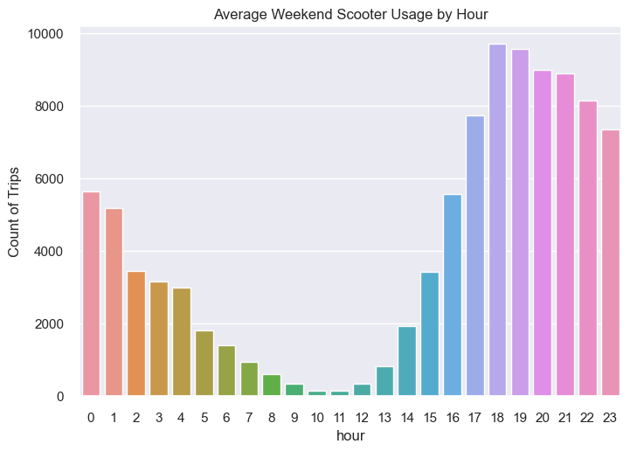
Typical Usage Patterns TIME Each graph represents the average number of trips taken during a particular hour of the day
Peak times were between the hours of 5PM and 1AM
Between the hours of 7AM and 11AM were the slowest
On May 4th, 2019 at 6PM had the highest number of scooters being used at 2,033

Slide 8
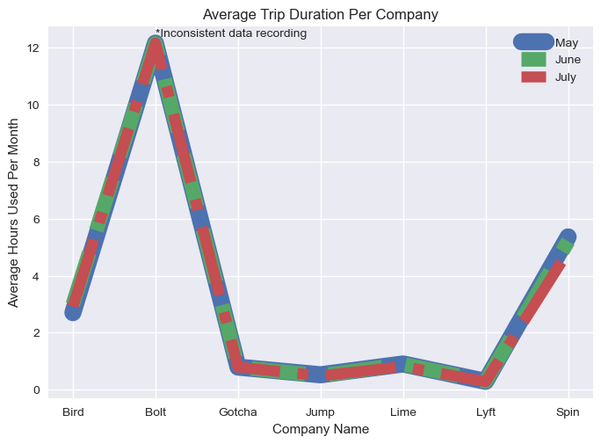
Typical Usage Patterns TRIP DURATION
The number of hours that a scooter was used stay consistent with all companies over the time period of May, June and July except for Lyft

Slide 9
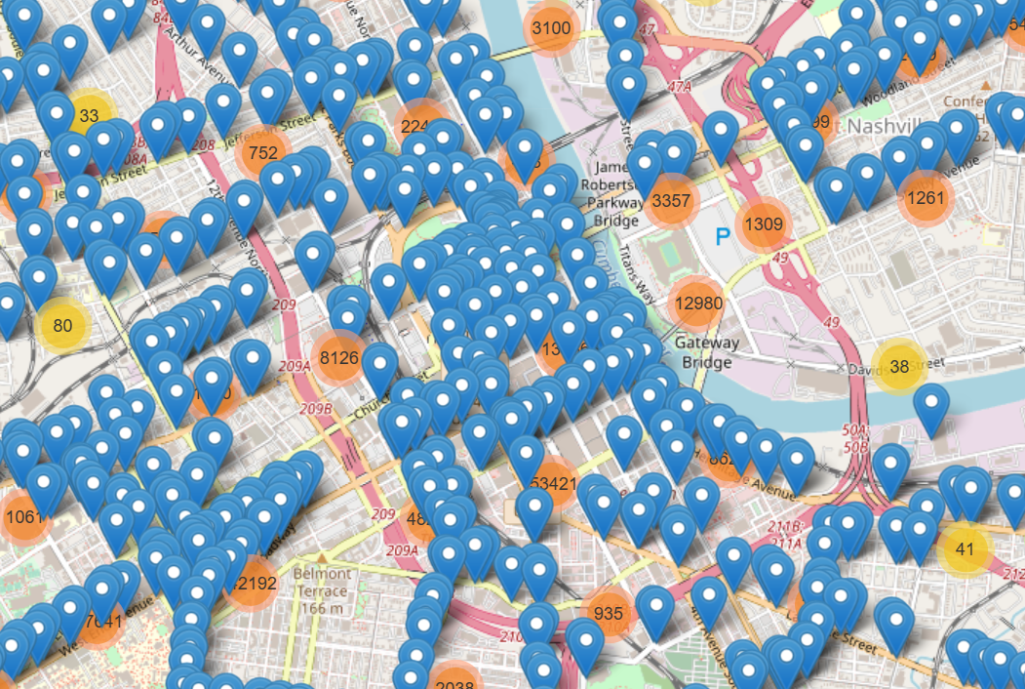
Typical Usage Patterns LOCATION
Calculated the starting locations of the scooters
Found most scooters were used in the downtown area
By clicking on the map, a new window will open to view an interactive map
The next slide will provide more detail on typically usage

Slide 10
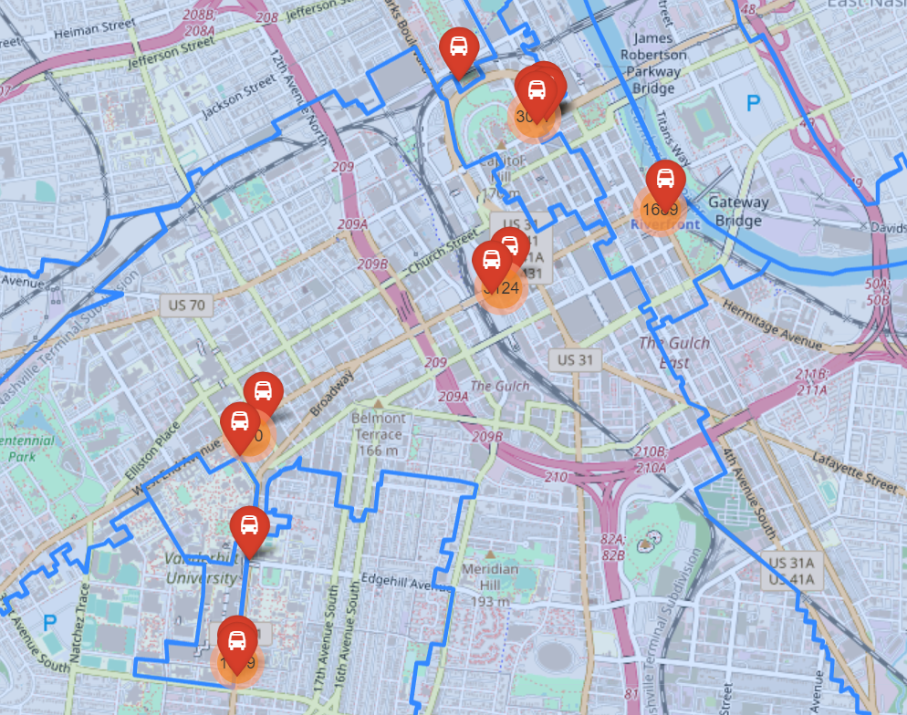
Are scooters used to provide transportation from public transit hubs to work or school?
Map of Trips that started 250 feet of less from Regional Transit Authority bus stop and went a mile of less.
7026 trips started near RTA bus stops.

Slide 11
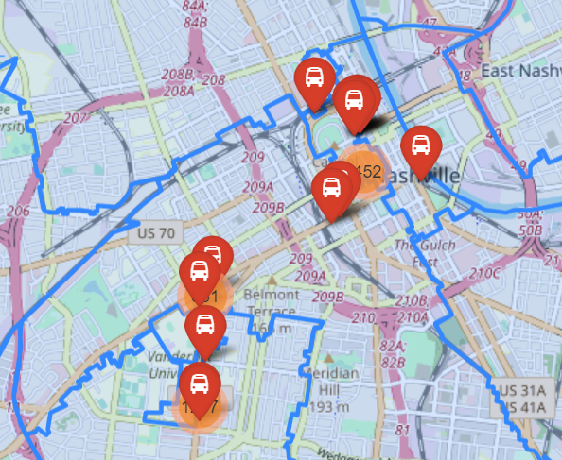
Are scooters used to provide transportation from public transit hubs to work or school?
Map of Trips that ended 250 feet of less from Regional Transit Authority bus stop and went a mile or less.
6505 trips ended near RTA bus stops.
Scooters were used 13531 times as “last mile” transportation.
Given a total of 485,222 trips provided in the data, “last mile” transportation accounted for only 2.8%

Slide 12
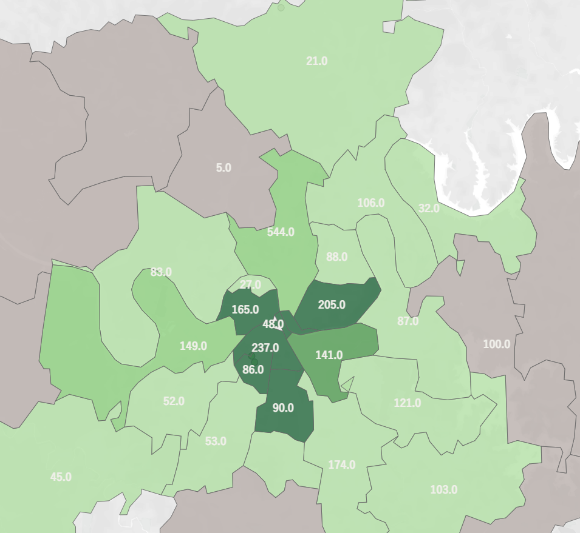
Are scooters used to provide transportation from public transit hubs to work or school?

Slide 13
Recommendations:
* Metro Nashville had a goal of each scooter being used 3 times per day. Each scooter only averaged one trip per day.
-Over saturation of scooters
* Rearranging the location of scooters to areas that have a lot of bus stops, but no scooters. In area codes 37076 and 37027 have a total of 181 bus stops but no scooters available for use.
*

